Slide 1
Real-Time Systems
Dr. Muazzam A. Khan

Slide 2
Objectives
To explain the timing requirements of real-time systems
To distinguish between hard and soft real-time systems
To discuss the defining characteristics of real-time systems
To describe scheduling algorithms for hard real-time systems

Slide 3
Real Time System
A system is said to be Real Time if it is required to complete it’s work & deliver it’s services on time.
Example – Flight Control System
  All tasks in that system must execute on time.
An embedded system is a computing device that is part of a larger system (I.e. automobile, airline.)
A safety-critical system is a real-time system with catastrophic results in case of failure.

Slide 4
Real Time System
Hard Real Time System
  A hard real-time system guarantees that real-time tasks be completed within their required deadlines.
  Failure to meet deadlines is fatal
  example : Flight Control System
Soft Real Time System
  A soft real-time system provides priority of real-time tasks over non real-time tasks.
  Late completion of jobs is undesirable but not fatal.
  System performance degrades as more & more jobs miss deadlines like online database.

Slide 5
Role of an OS in Real Time Systems
Standalone Applications
  Often no OS involved
  Micro controller based Embedded Systems
Some Real Time Applications are huge & complex
  Multiple threads
  Complicated Synchronization Requirements
  File system / Network / Windowing support

Slide 6
System Characteristics
Single purpose
Small size
Inexpensively mass-produced
Specific timing requirements

Slide 7
Real Time OS Characteristics
  Scheduling.
  Resource Allocation.
  Interrupt Handling.
  Other issues like kernel size.

Slide 8
Scheduling in RTOS
More information about the tasks are known
  Number of tasks
  Resource Requirements
  Release Time
  Execution time
  Deadlines
Being a more deterministic system better scheduling algorithms can be devised.

Slide 9
Scheduling Algorithms in RTOS
Clock Driven Scheduling
Weighted Round Robin Scheduling
Priority Scheduling
(Greedy / List / Event Driven)

Slide 10
Clock Driven Scheduling
  All parameters about jobs (release time/ execution time/deadline) known in advance.
  Schedule can be computed offline or at some regular time instances.
  Minimal runtime overhead.
  Not suitable for many applications.

Slide 11
Weighted Round Robin Scheduling
Jobs scheduled in FIFO manner
Time quantum given to jobs is proportional to it’s weight
  Example use : High speed switching network
    QOS guarantee.
  Not suitable for precedence constrained jobs.
    Job A can run only after Job B. No point in giving time quantum to Job A before Job B.

Slide 12
Priority Scheduling
Priority Scheduling
(Greedy/List/Event Driven)
  Processor never left idle when there are ready tasks
  Processor allocated to processes according to priorities
  Priorities
    Static - at design time
    Dynamic - at runtime

Slide 13
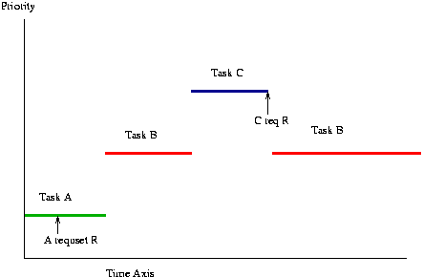
Priority Inversion

Slide 14
Priority Scheduling
Earliest Deadline First (EDF)
  Process with earliest deadline given highest priority
Least Slack Time First (LSF)
  slack = relative deadline – execution left
Rate Monotonic Scheduling (RMS)
  A priority assignment algorithm used in real-time operating systems (RTOS) with a static-priority scheduling class.
  Tasks priority inversely proportional to it’s period

Slide 15
Resource Allocation in RTOS
Resource Allocation
  The issues with scheduling applicable here.
  Resources can be allocated in
    Weighted Round Robin
    Priority Based
Some resources are non preemptible
  Example : semaphores (protected variable that can facilitate and restrict access to shared resources)
Priority Inversion if priority scheduling is used

Slide 16
System-on-a-Chip
Many real-time systems are designed using system-on-a-chip (SOC) strategy.
SOC allows the CPU, memory, memory-management unit, and attached peripheral ports (I.e. USB) to be contained in a single integrated circuit.

Slide 17

Bus-Oriented System

Slide 18
Features of Real-Time Kernels
Most real-time systems do not provide the features found in a standard desktop system.
Reasons include
  Real-time systems are typically single-purpose.
  Real-time systems often do not require interfacing with a user.
  Features found in a desktop PC require more substantial hardware.

Slide 19
Virtual Memory in Real-Time Systems
Real-addressing mode where programs generate physical addresses.
  A draw back with real addressing mode is the absence of memory protection between processors.
  A benefit is that the system is quite fast no time spent on address translation.
(2) Relocation register mode.
Here a register R is set to memory location, where program is loaded.
Full virtual memory.
In this instance address translation takes place in Page Table & TLB.

Slide 20
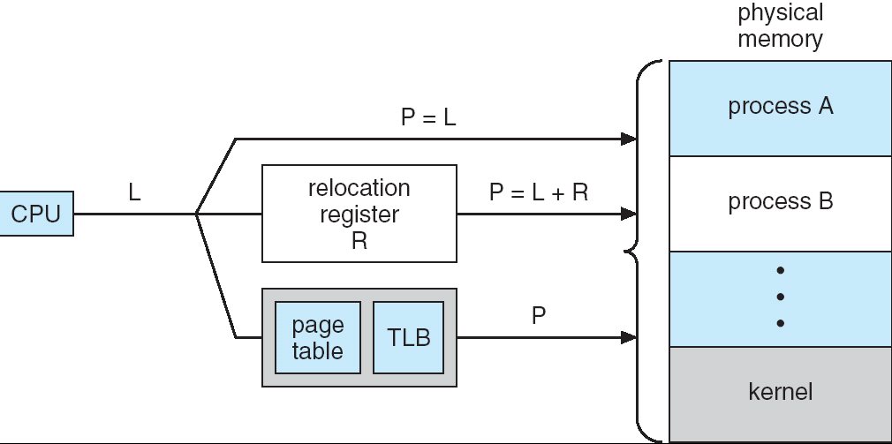
Address Translation
L must be mapped with P
L= Logical Address
P= Physical Address
R= Relocation Register

Slide 21
Implementing Real-Time Operating Systems
In general, real-time operating systems must provide:
(1) Preemptive, priority-based scheduling
(2) Preemptive kernels
(3) Latency must be minimized
(4) Networking Support

Slide 22
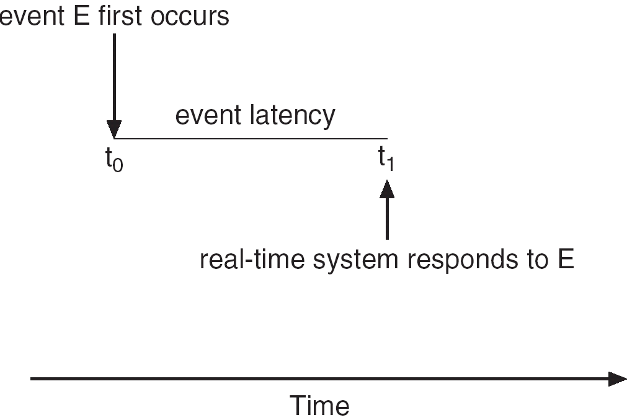
Minimizing Latency
Event latency is the amount of time from when an event occurs to when it is serviced.

Slide 23
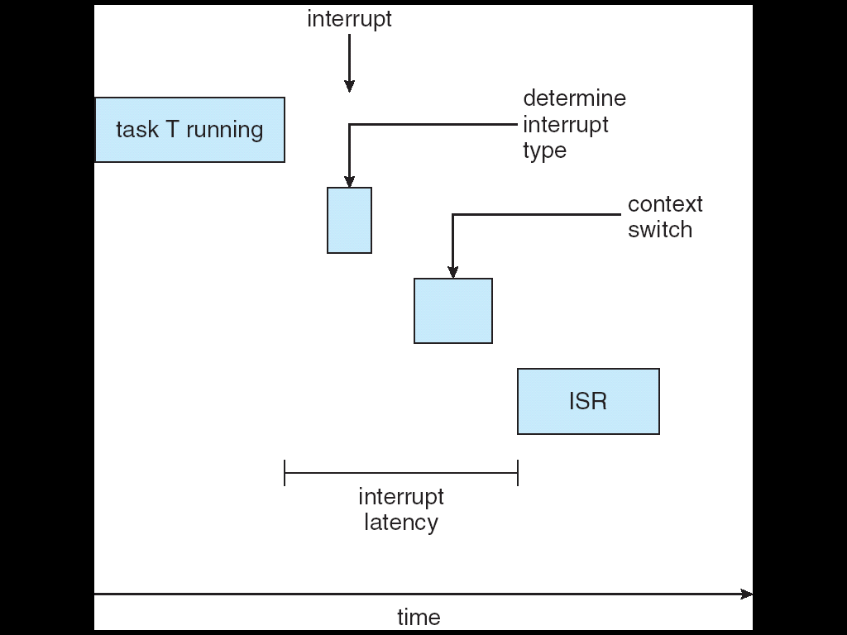
Interrupt Latency
Interrupt latency is the period of time from when an interrupt arrives at the CPU to when it is serviced.
Interrupt Service Routine

Slide 24
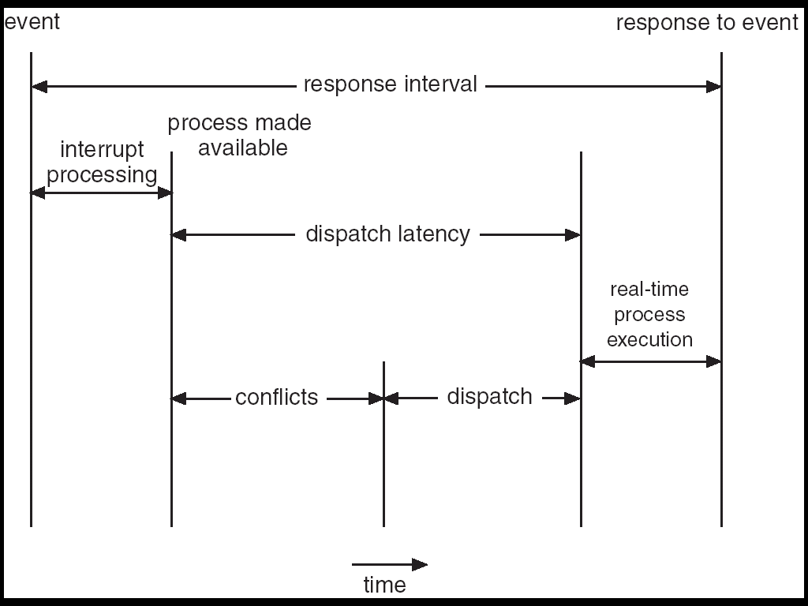
Dispatch Latency
Dispatch latency is the amount of time required for the scheduler to stop one process and start another.

Slide 25
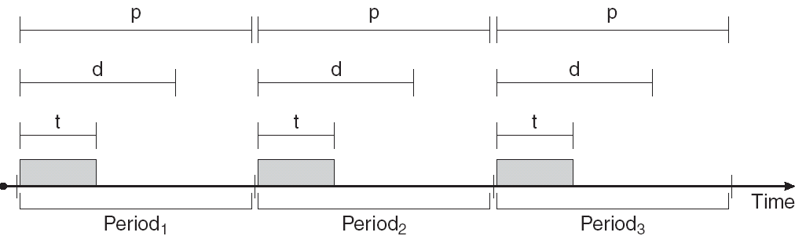
Real-Time CPU Scheduling
Periodic processes require the CPU at specified intervals (periods)
p is the duration of the period
d is the deadline by when the process must be serviced
t is the processing time
Scheduler can assign priorities according to the deadline.

Slide 26
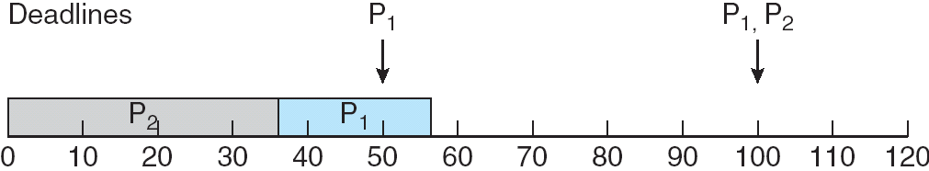
Scheduling of tasks when P₂ has a higher priority than P₁

Slide 27
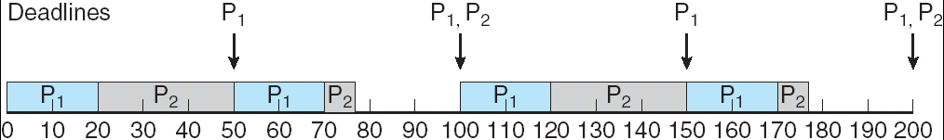
Rate Montonic Scheduling
A priority is assigned based on the inverse of its period
P₁ is assigned a higher priority than P₂.

Slide 28

Missed Deadlines with
Rate Monotonic Scheduling

Slide 29

Earliest Deadline First Scheduling
Priorities are assigned according to deadlines:
the earlier the deadline, the higher the priority;
the later the deadline, the lower the priority.

Slide 30
Proportional Share Scheduling
T shares are allocated among all processes in the system.
An application receives N shares where N < T.
This ensures each application will receive N / T of the total processor time.

Slide 31
POSIX-Pthread Scheduling
The P-thread API provides functions for managing real-time threads.
It allows a program to control multiple different flows of work that overlap in time.
P-threads defines two scheduling classes for real-time threads:
(1) SCHED_FIFO - threads are scheduled using a FCFS strategy with a FIFO queue. There is no time-slicing for threads of equal priority.
(2) SCHED_RR - similar to SCHED_FIFO except time-slicing occurs for threads of equal priority.

Slide 32
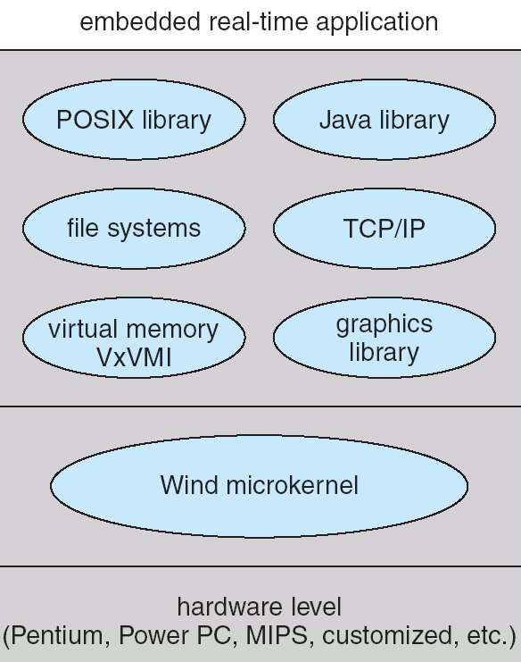
VxWorks 5.0
VxWorks is a real-time operating system (RTOS) developed as proprietary software by Wind River of Alameda, California, US

Slide 33
Wind Microkernel
The Wind microkernel provides support for the following:
(1) Processes and threads;
(2) preemptive and non-preemptive round-robin scheduling;
(3) manages interrupts (with bounded interrupt and dispatch latency times);
(4) shared memory and message passing inter-process communication facilities.

Slide 34
The End

